Slide 1





FLOW OF LIFE: LINK BETWEEN WATER & HEALTH
Piyara Perera
Sajini Udawela
Maleesha Nissanka

Slide 2
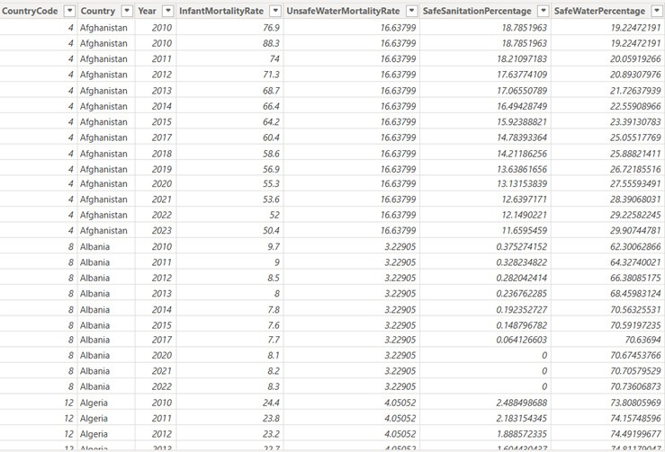
About the Data
Water & sanitation access (SDG 6) directly influences disease spread and mortality, especially among children under five (SDG 3).
We explore this relationship.

Slide 3
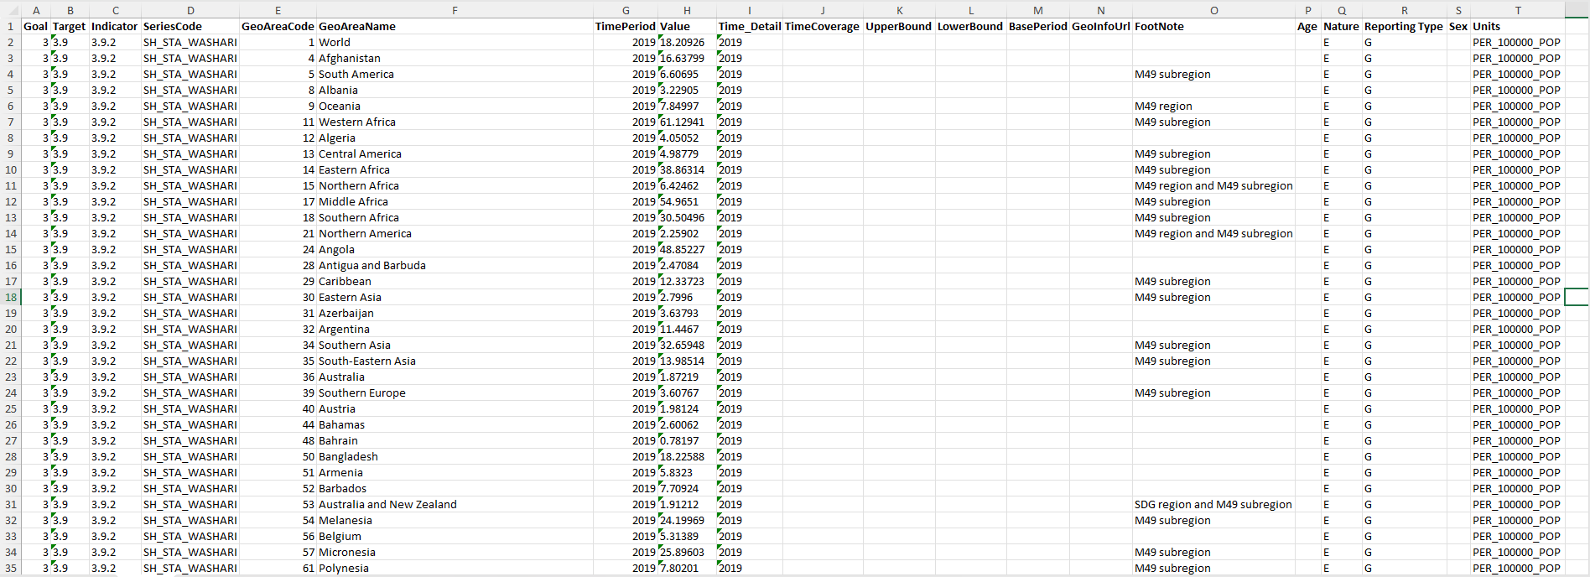
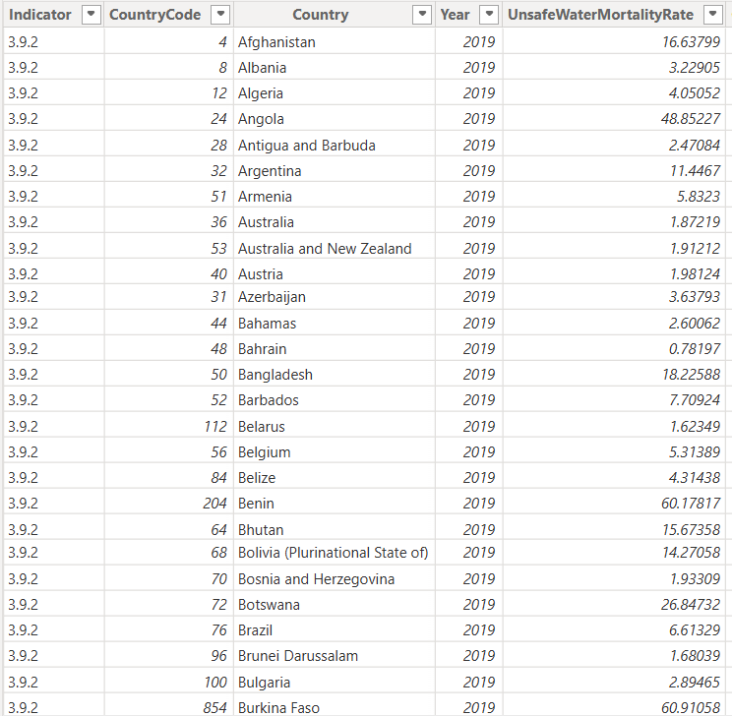
Cleaned
Finally, we merged the four cleaned tables using Country and Year to create the final merged dataset.

Slide 4
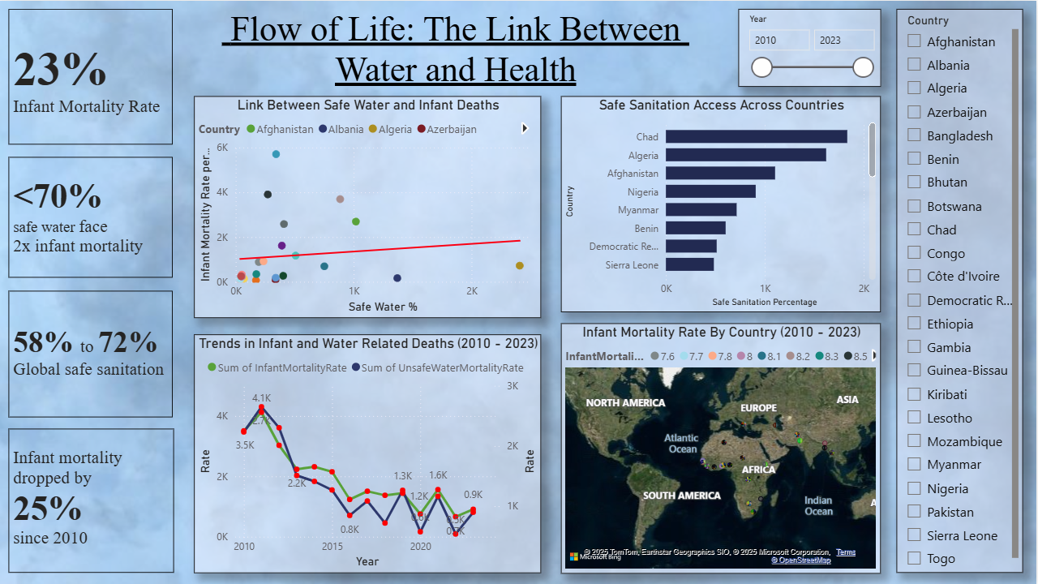

Slide 5


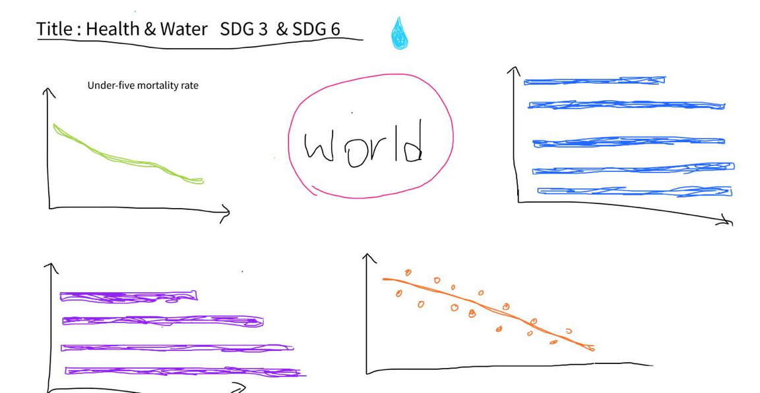
Design Process
Design Goals
Easy to understand
Show clear comparisons
Highlight link between water & health
Keep layout neat and simple
Rough Sketch 1

Slide 6









Design Process
Line chart
shows change over time
Choropleth Map
shows differences by country
Scatter plot
shows relationships
Bar chart
compares top vs bottom countries
Slicer
interactively explore data

Slide 7


Dashboard Evaluation
Quality of the Dashboard
Clear and easy to read
Chart types match the data
Interactive filtering helps explore trends
Designed to avoid clutter and confusion

Slide 8

Insights
01.
Higher clean water = Lower Mortality
Sub-Saharan Africa has the lowest access to water, sanitation, and hygiene
03.
Countries with strong water infrastructure = Low Mortality
02.

Slide 9



Team Collaboration Reflection
Tasks divided by strengths
2. Worked together to review and refine
Decisions made as a group
Piyara: Data cleaning & merging tables
Sajini: Visualization of charts
Maleesha: Presentation & narrative design
Made and designed the dashboard

Slide 10


THANK YOU!

